Slide 1

Indian Institute of Technology, Kharagpur
Department of Industrial and Systems Engineering
Android Application for Faults Detection in Sensor Data Streams
Guided By: -
Prof. Mamata Jenamani
Mr. Ritwik Dash
Presented By: -
Kapil Shyam Zadpe (21IM60R16)

Slide 2

Objectives
Creating user friendly Android interface.
Creating login portal for various stakeholders
Fetching data from cloud/server
Deploying algorithms over server
Data Visualization

Slide 3
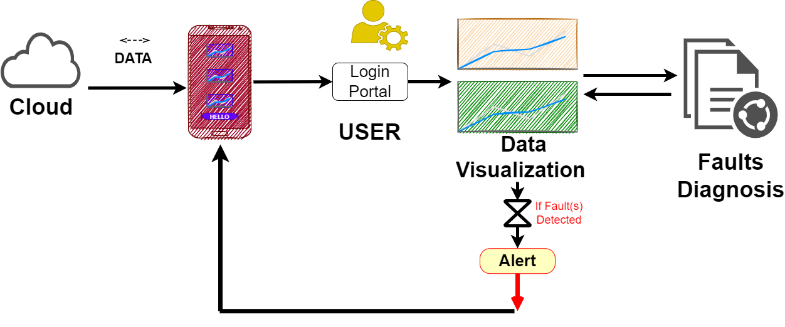
Flowchart of Work

Slide 4
Packages & Resources
Data Visualization
MPAndroidChart, GraphView, CustomGaugeView
Data Fetching – OKhttp3
AndroidStudio – Java Packages
Server – PythonAnyWhere, Flask
Backend – Python, Pandas, Numpy, Stastlab
StackOverFlow, Google

Slide 5
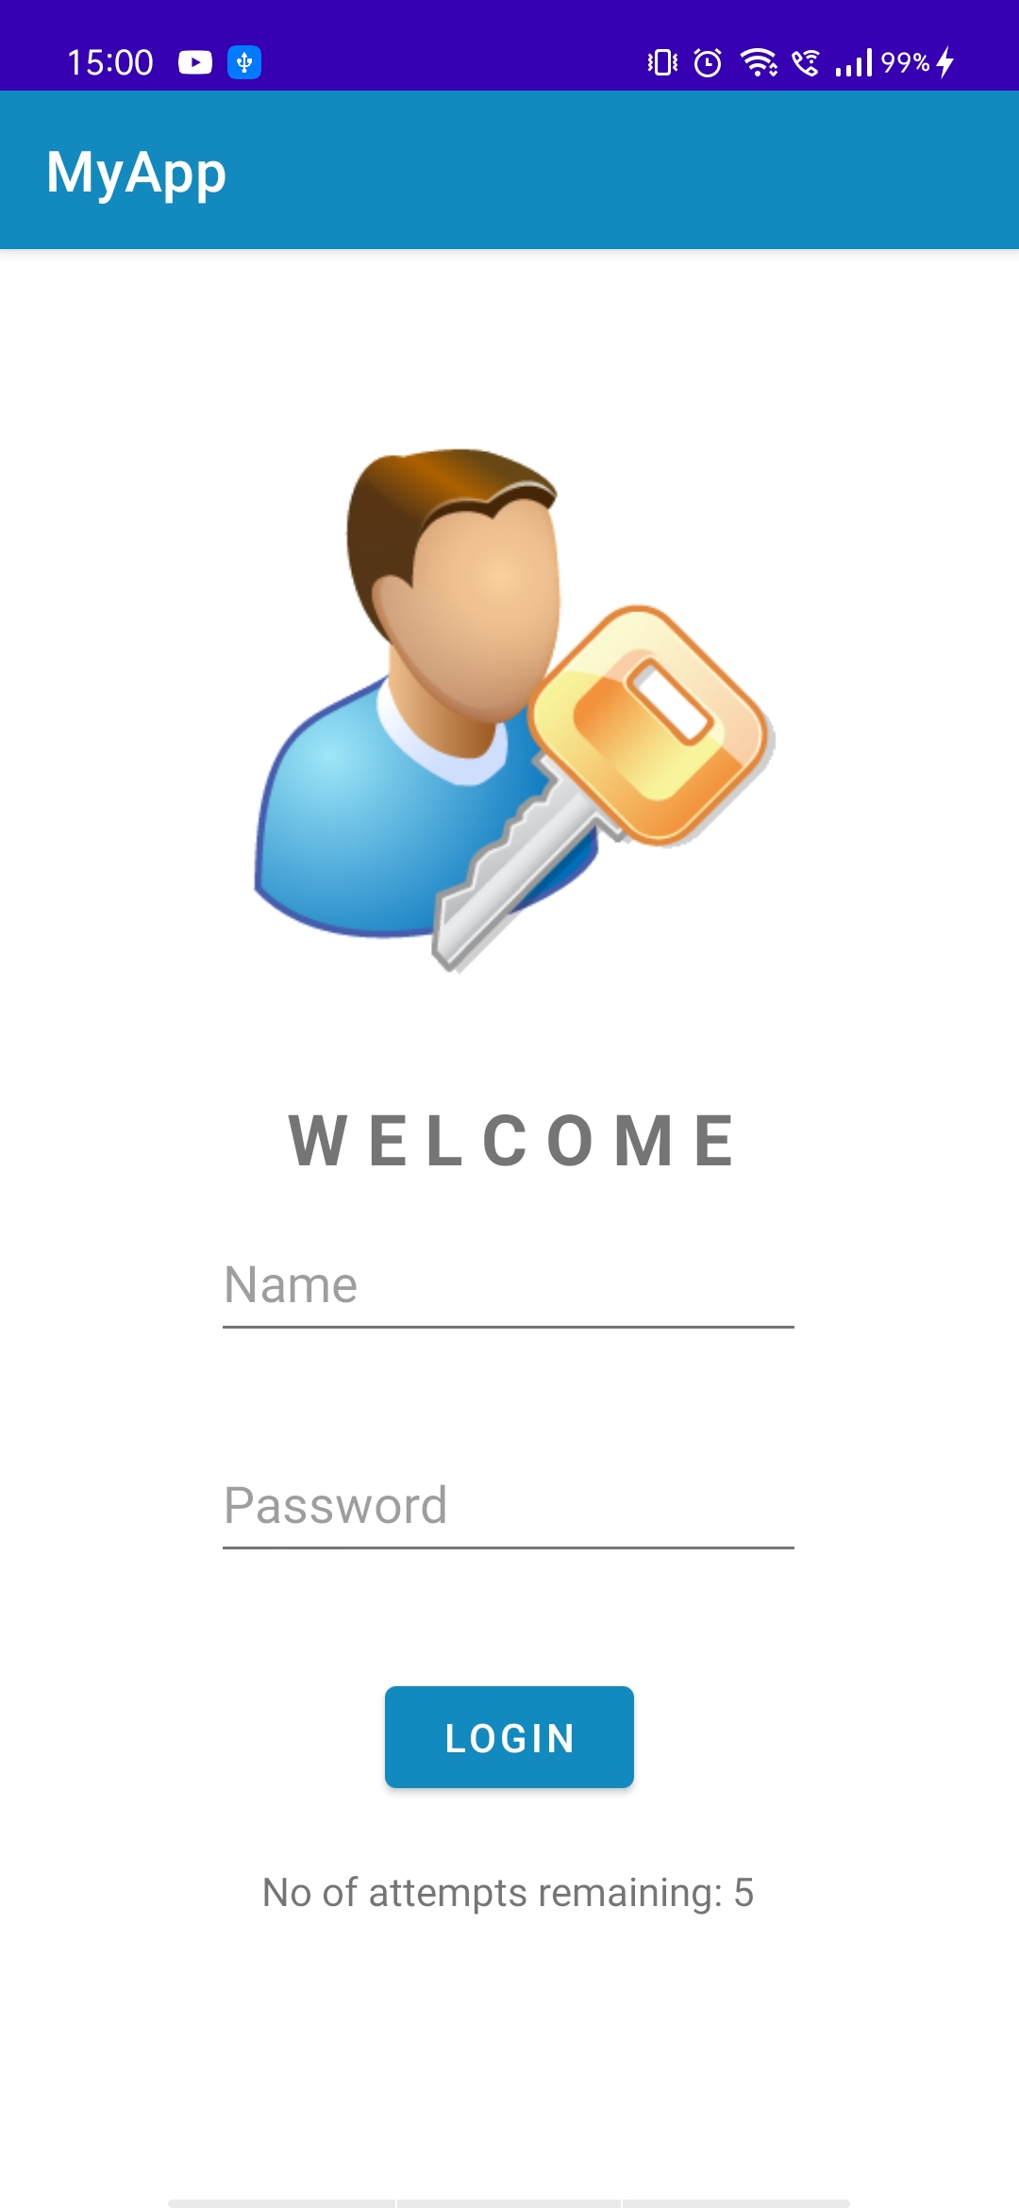
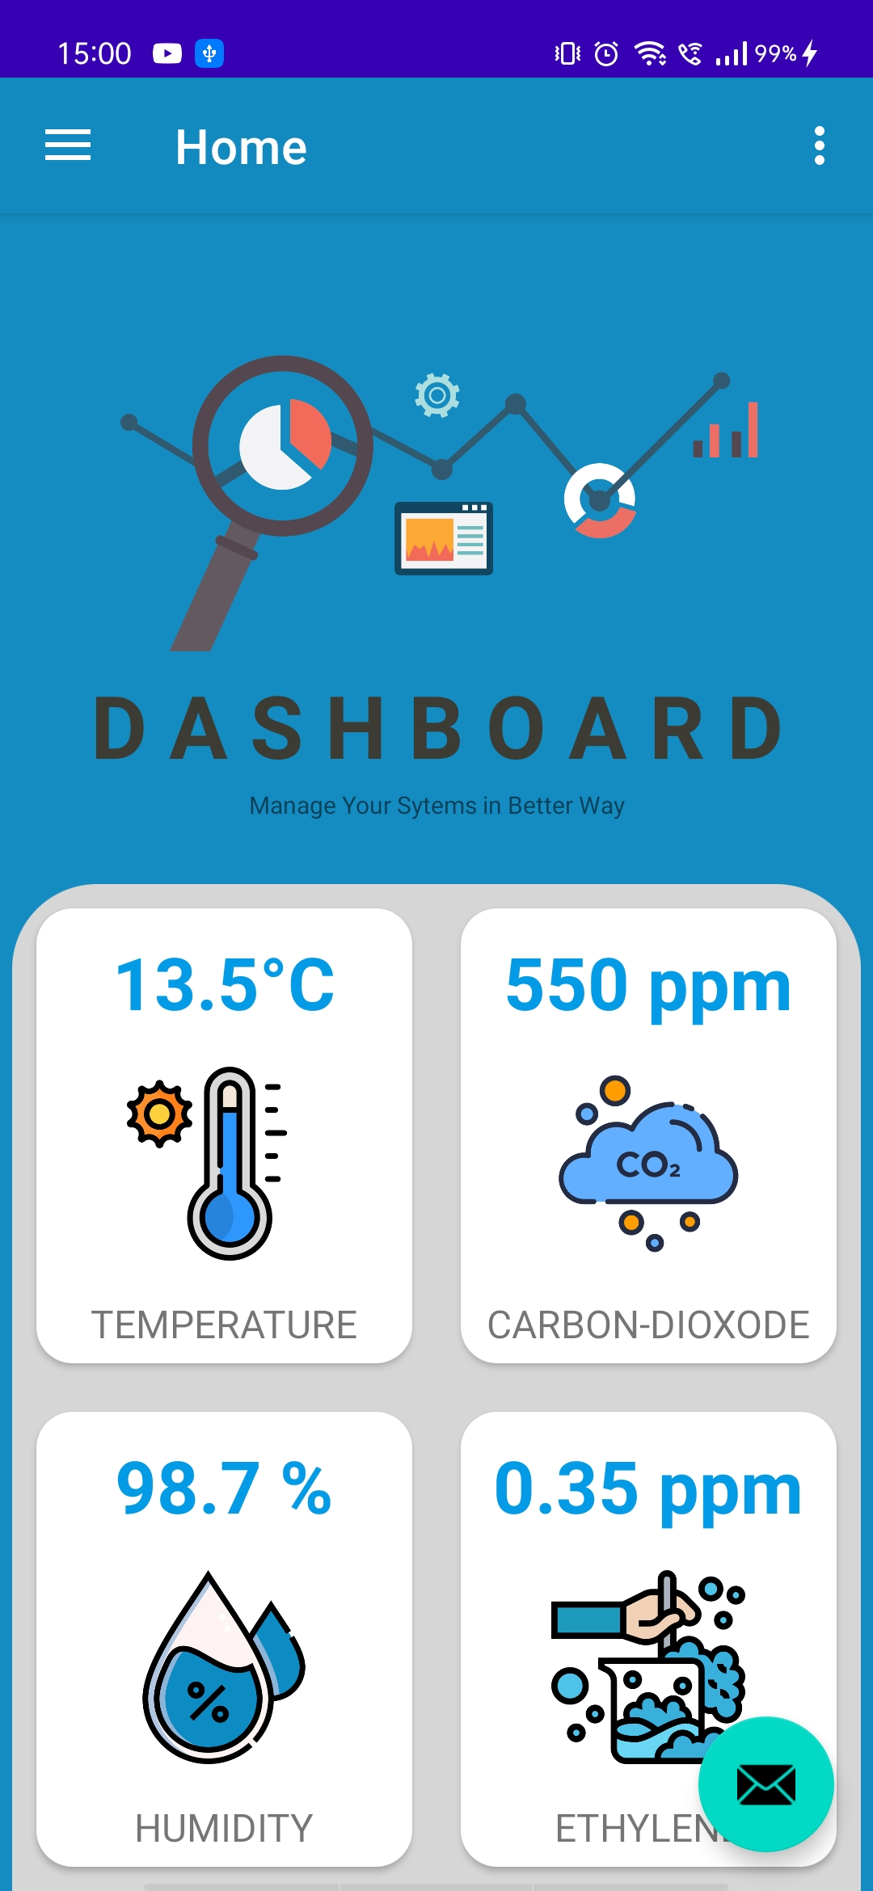
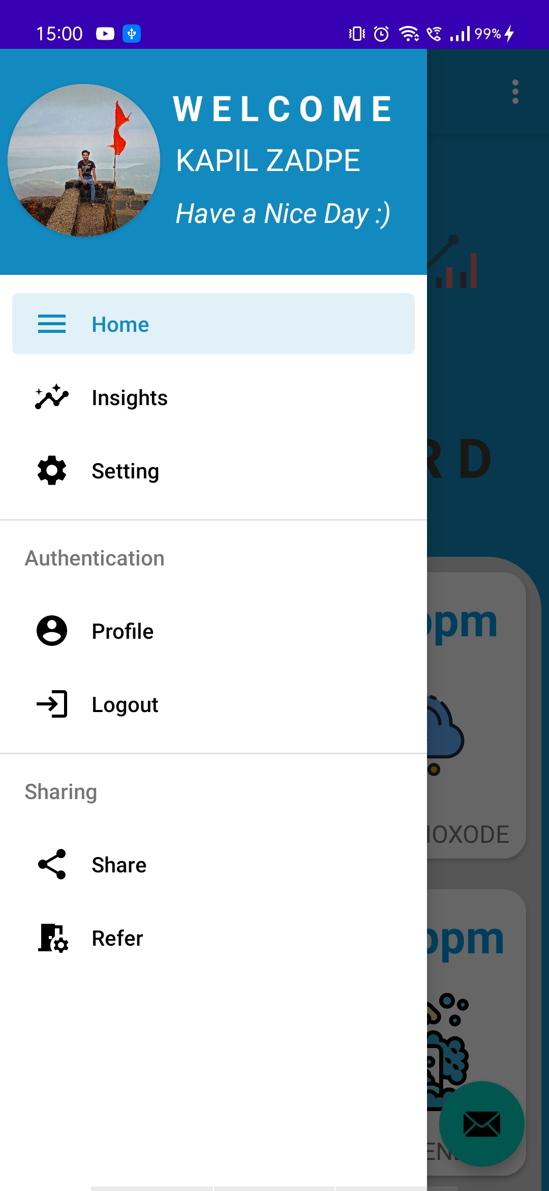
Android Working
Login Page

Slide 6
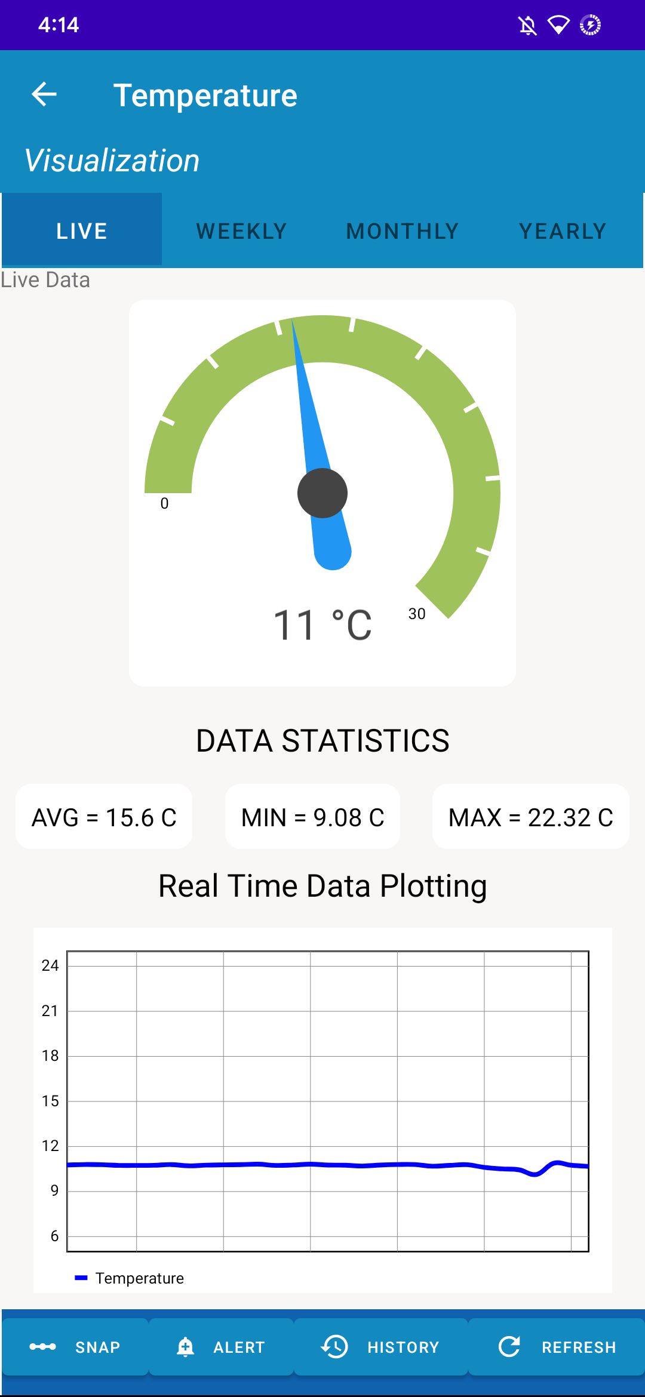
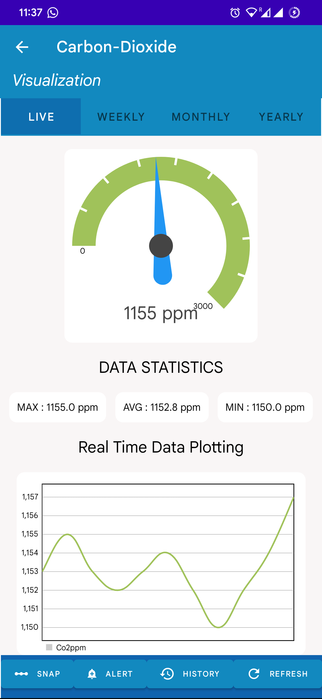
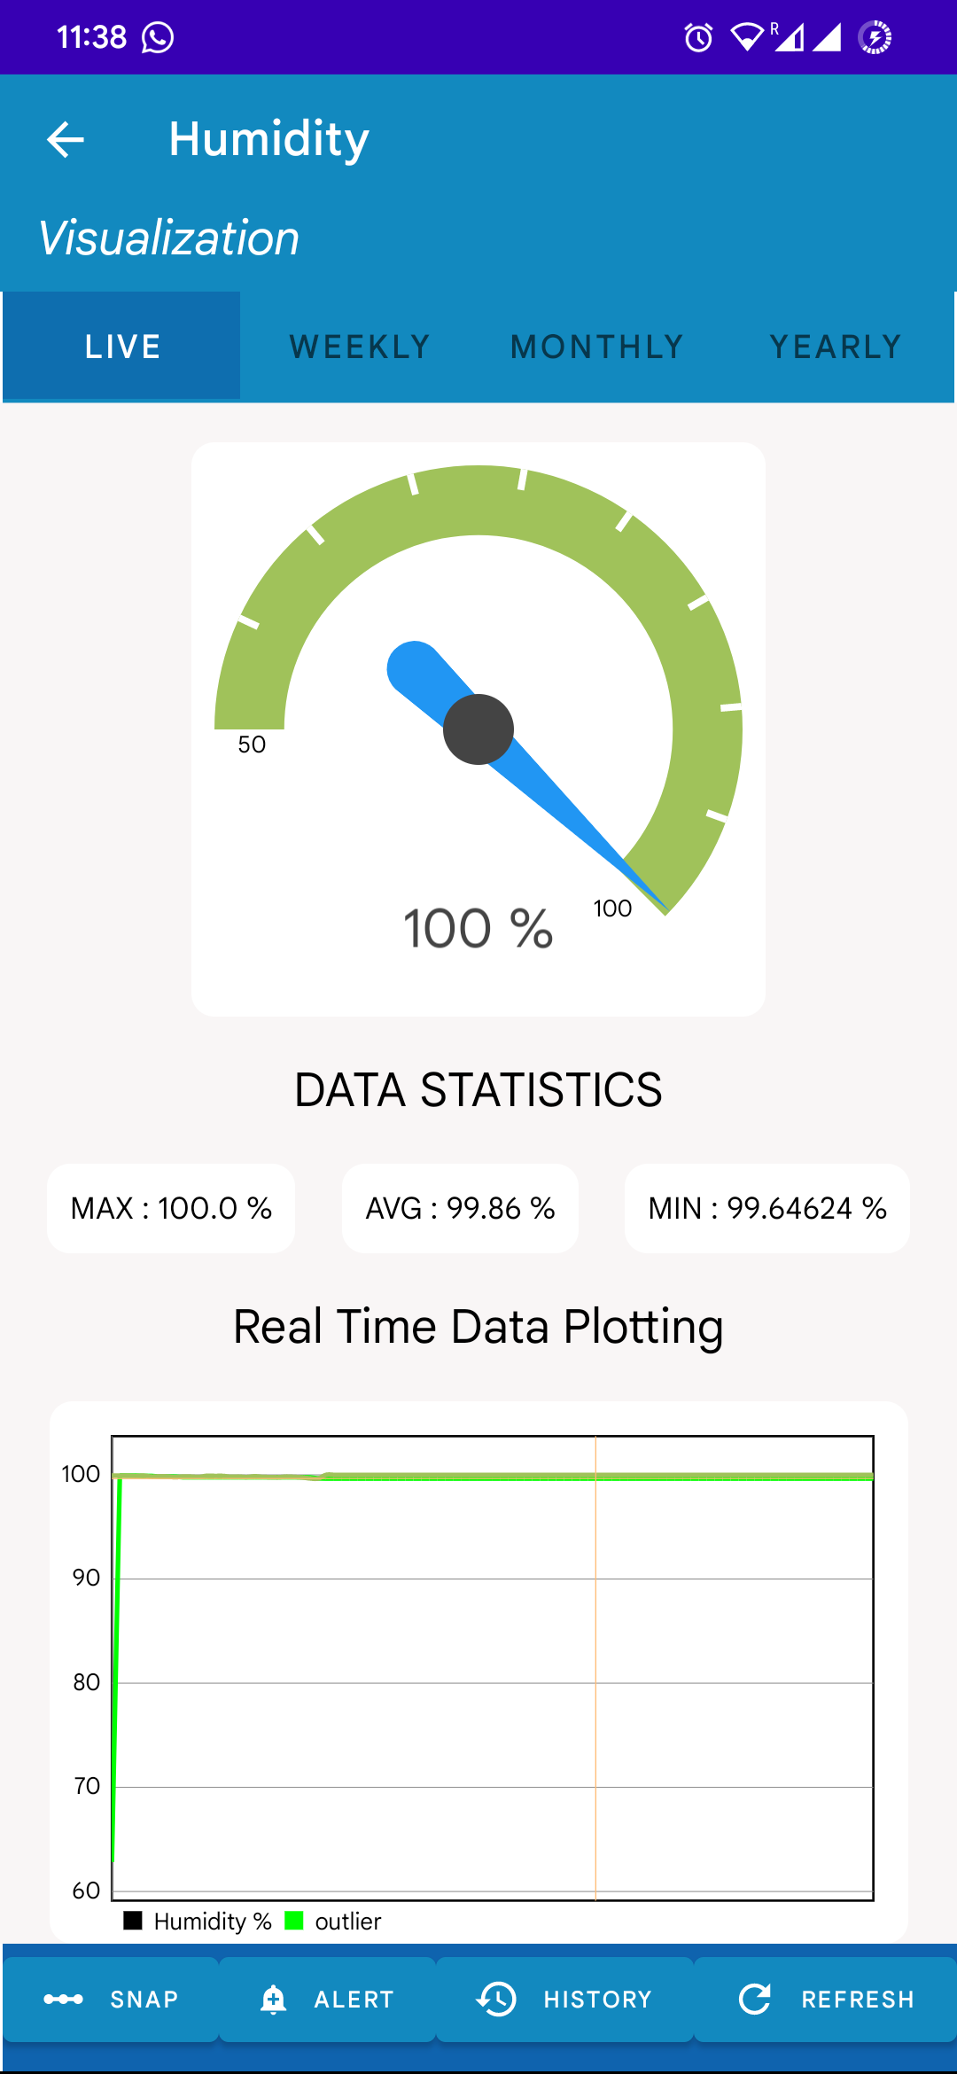
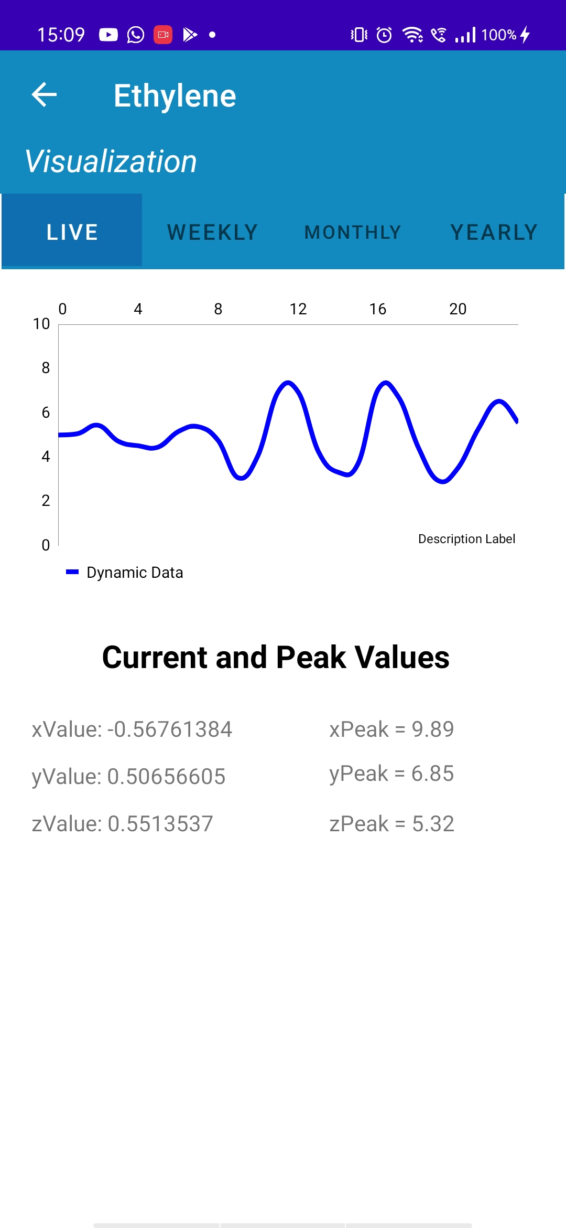
Weekly Progress Report
Home Page

Slide 7
Weekly Progress Report
Temperature Dashboard

Slide 8
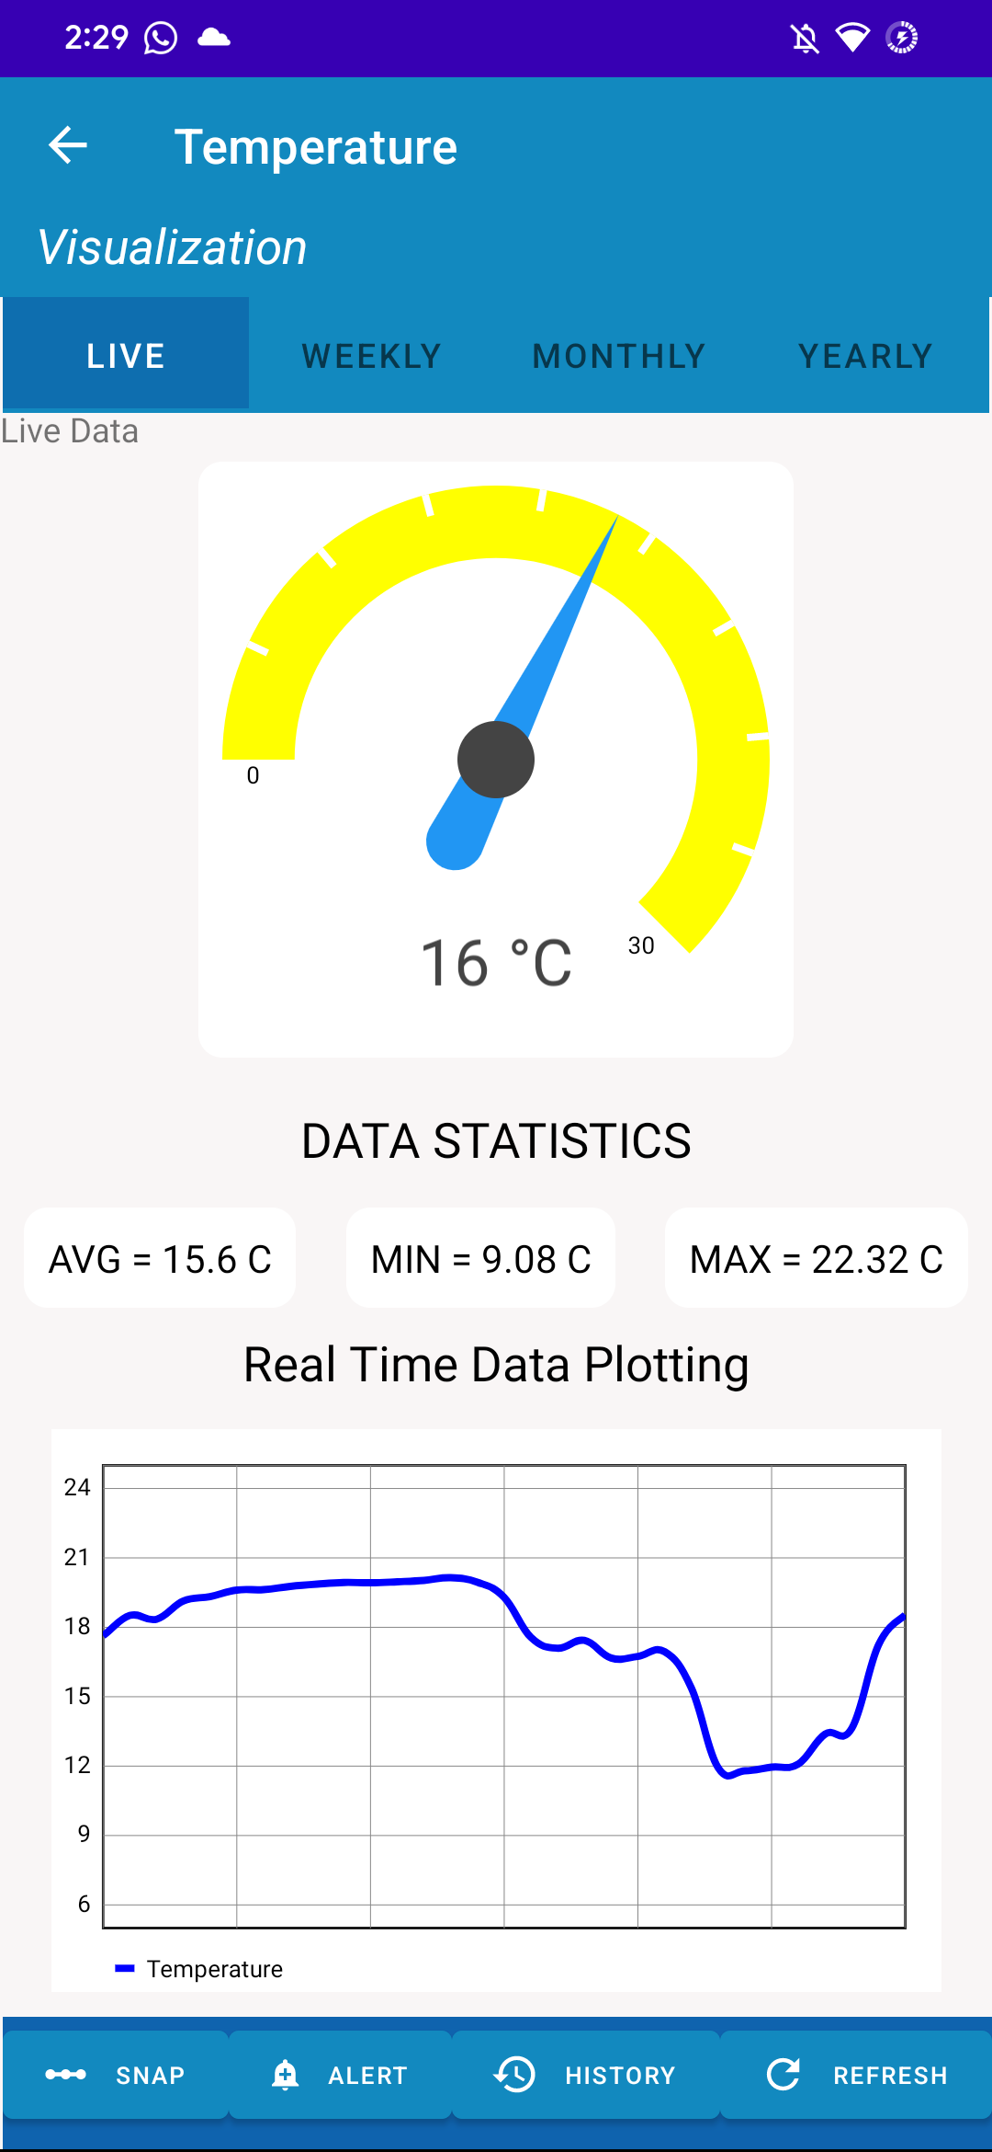
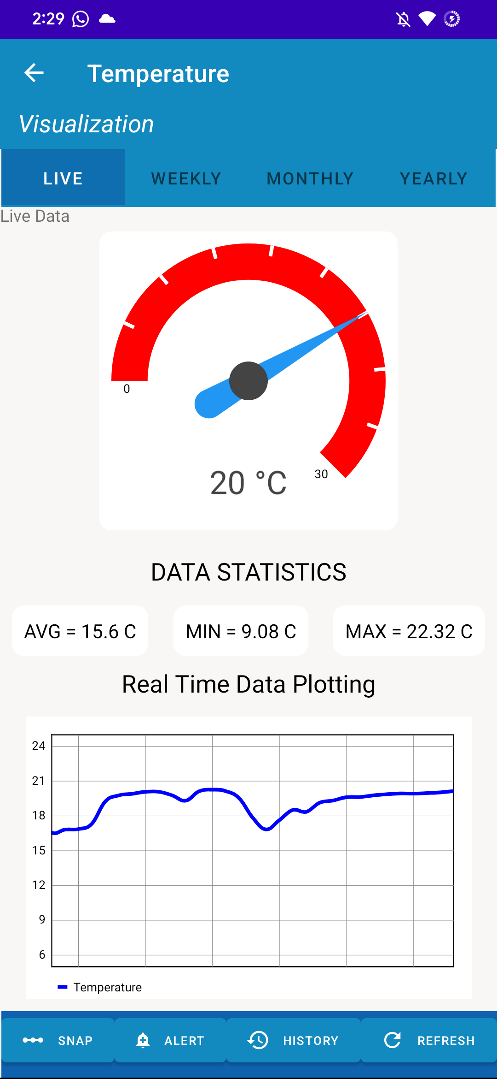
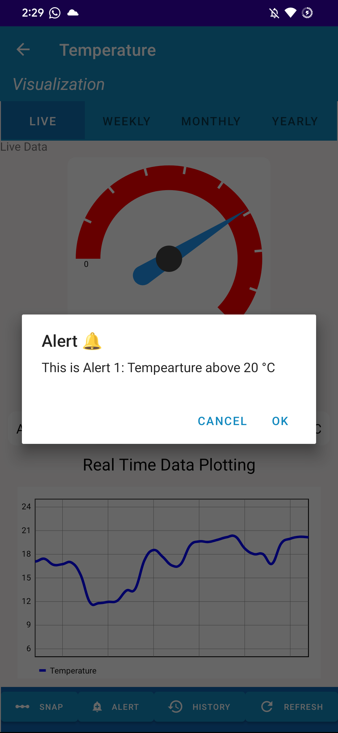
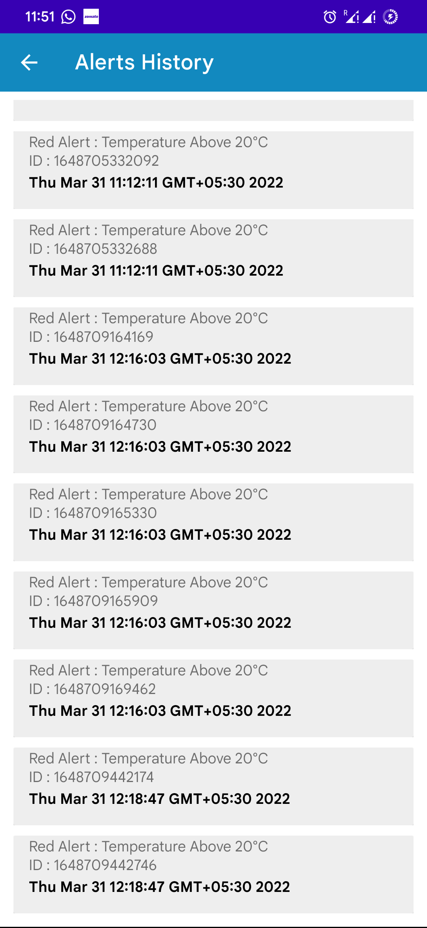
Android Working
Temp > 15
Temp > 20
Alert
Alerts Hist
Dashboard - Temperature

Slide 9
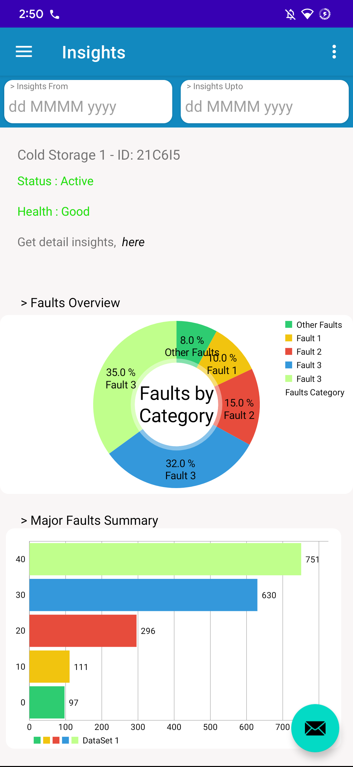
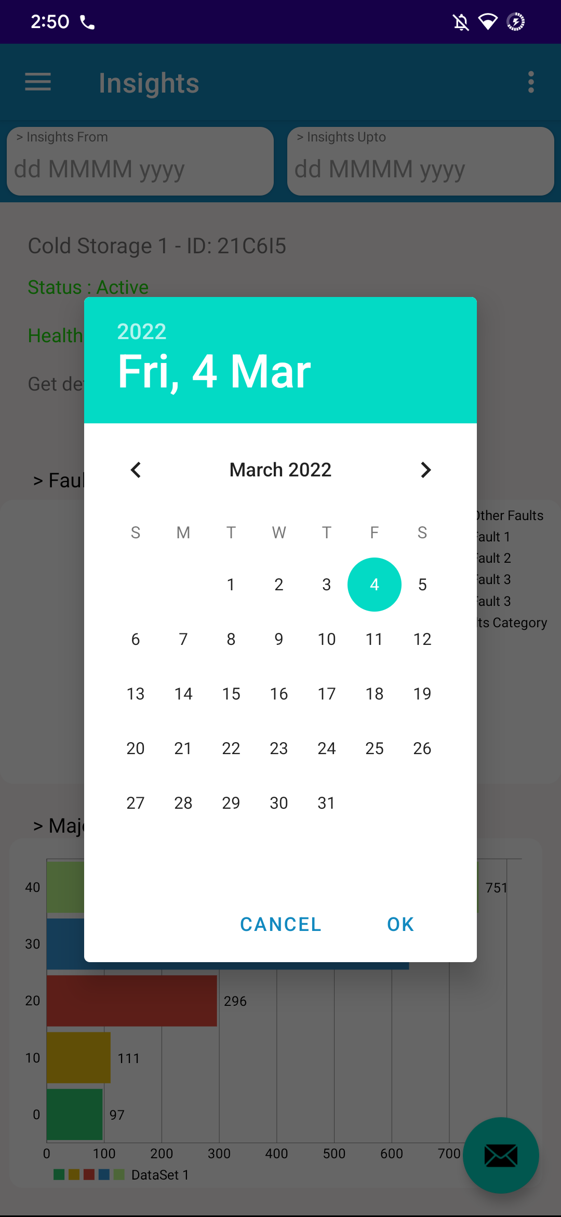
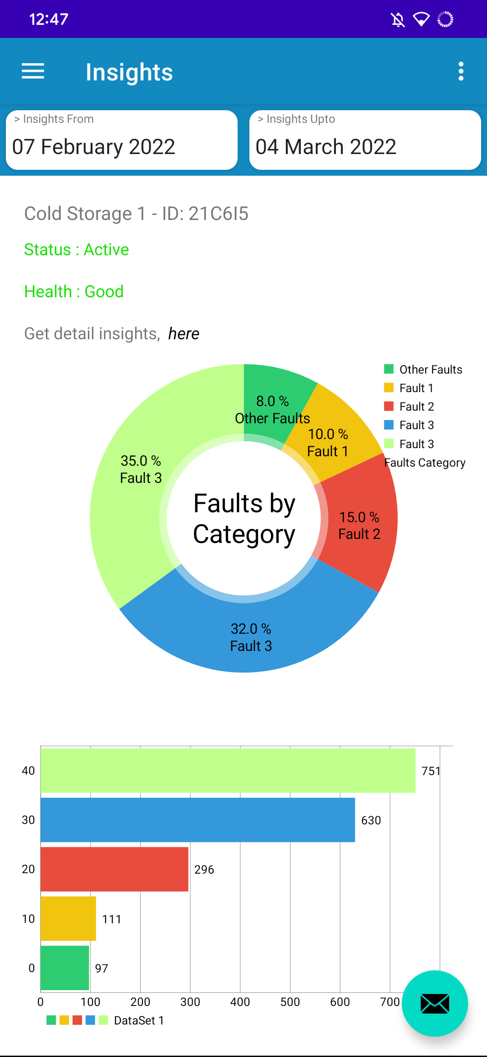
Android Working
Save Insights as PDF
From
From
To
Get Insights
Insights Window

Slide 10
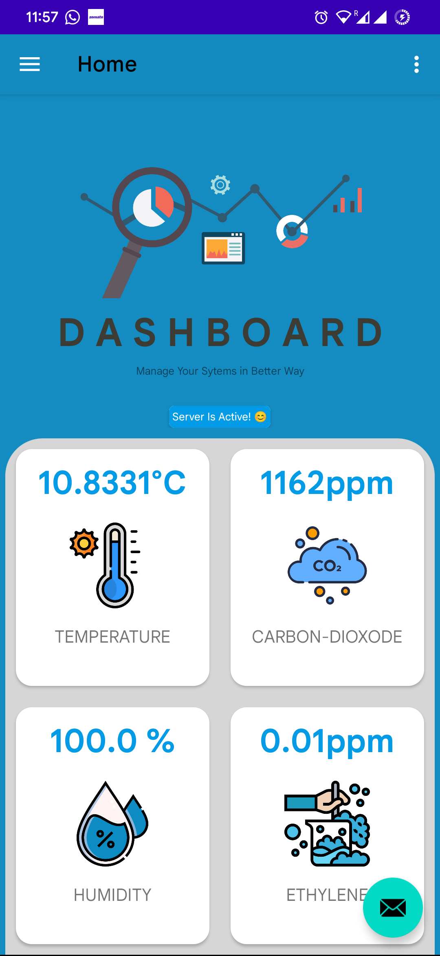
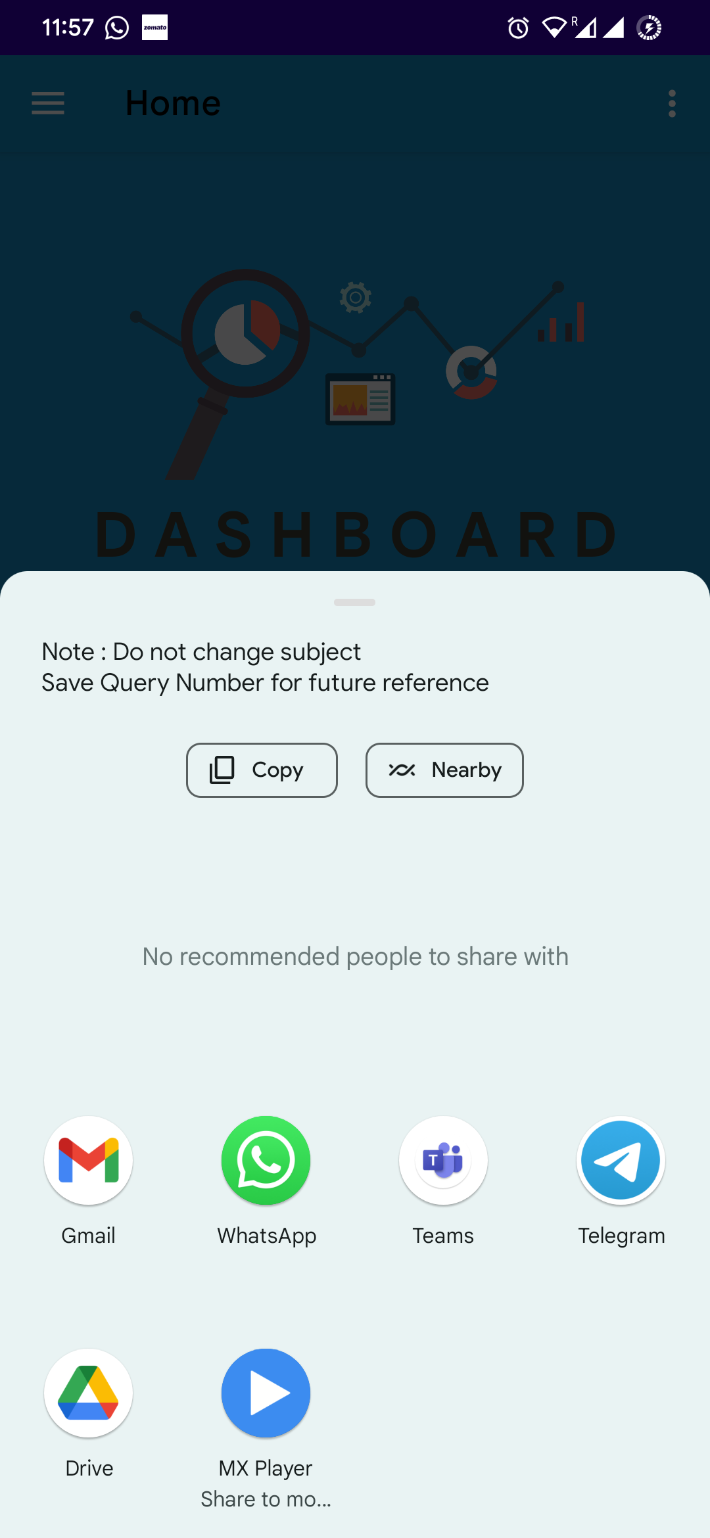
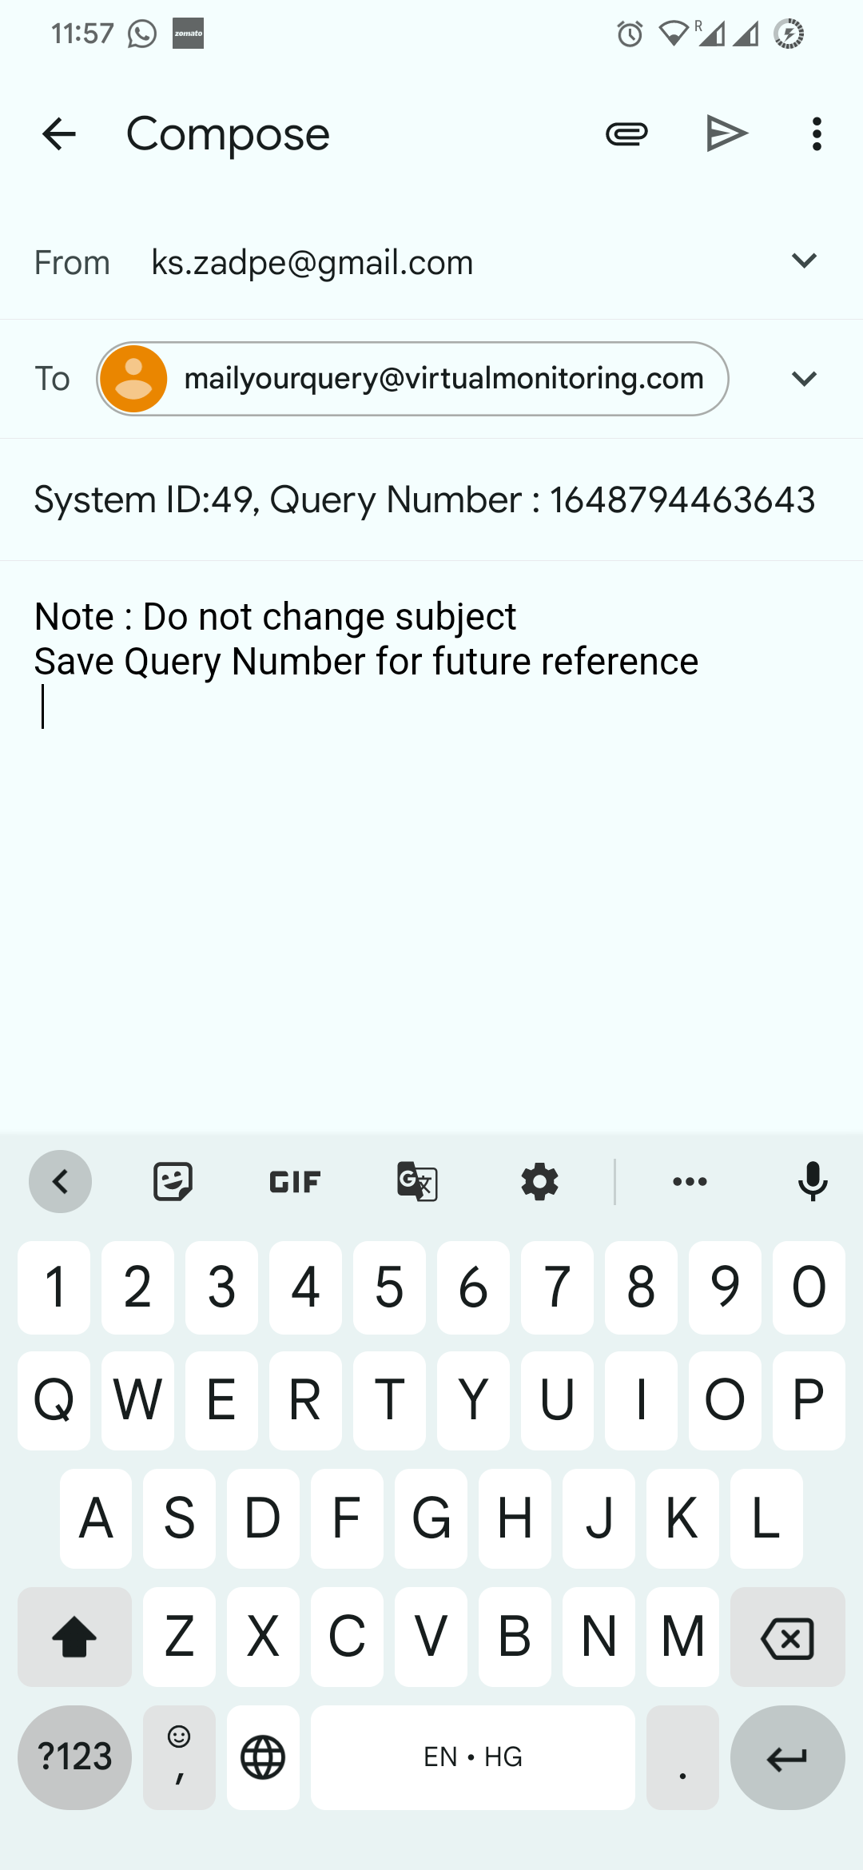
Android Studio
For Enquiry Purpose

Slide 11
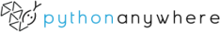

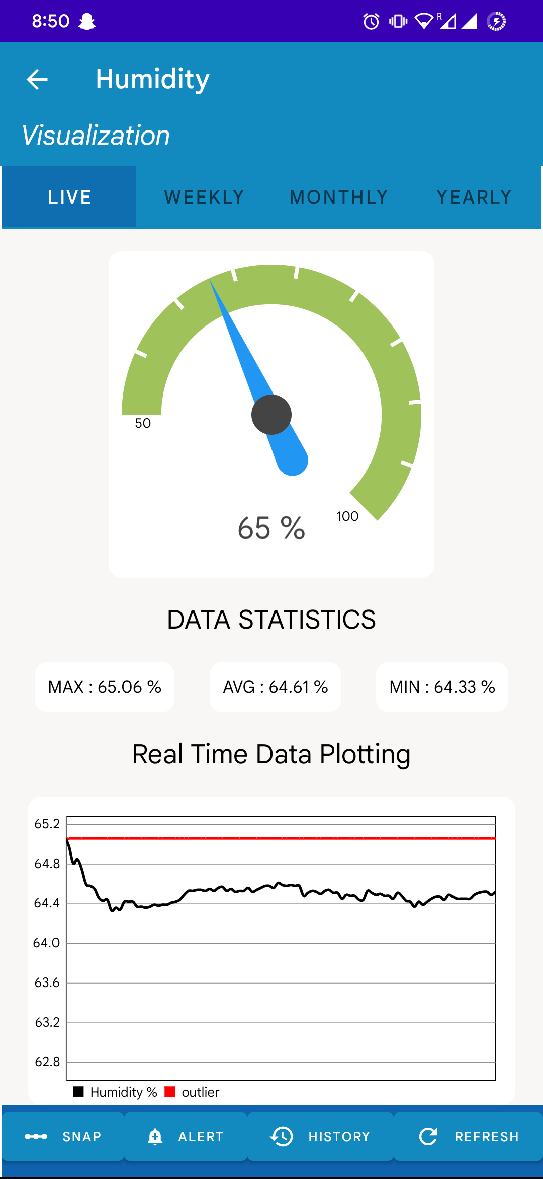
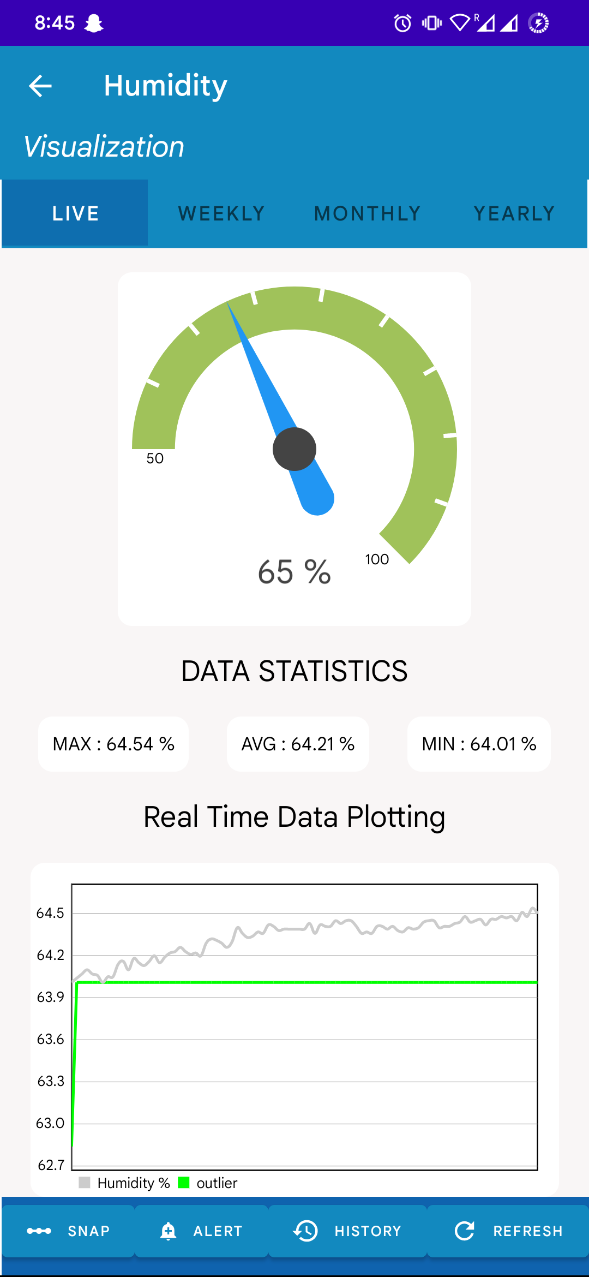

Weekly Progress Report
Weekly Progress Report
z-score > 3 x S.D
z-score < 3 x S.D
return 1
return 0
Outlier linechart = max humid
Outlier linechart = min humid
Outlier Detection Demo

Slide 12



Packages & Resources

